Slide 1
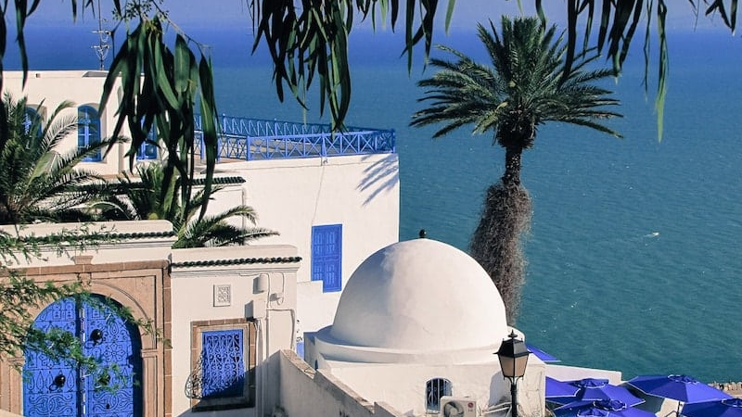
Business Presentation
Tunisia Hotel
Reservation Application
AI-Powered Interactive Tourism Platform
Interactive Map
AI Content Generation
Intelligent Assistant
2026
Confidential

Slide 2
Overview
Agenda
01
Executive Summary
02
Market Opportunity
Core value proposition & platform vision
Tunisia tourism boom & market gaps
03
Project Overview
04
Interactive Map
Platform architecture & user journey
Visual discovery & navigation features
05
AI State Descriptions
06
AI Hotel Content
Automated content for 24 governorates
Intelligent property descriptions
07
AI Travel Assistant
08
Technology Stack
Conversational AI for travelers
Architecture & AI integration
10
Conclusion
Next steps & investment opportunity

Slide 3
Introduction
Executive Summary
Vision
Key Differentiators
Revolutionize Tunisia's tourism booking experience through an AI-powered platform that combines interactive mapping technology with intelligent content generation . Our solution transforms how travelers discover, explore, and book accommodations across all 24 Tunisian governorates.
AI-Powered Content
Auto-generated descriptions for states & hotels
Interactive Map
Visual exploration of all 24 governorates
Travel Assistant
Conversational AI for travel queries
Core Value Proposition
Multilingual Support
First hotel reservation platform specifically designed for Tunisia's unique tourism landscape, featuring an interactive map that visualizes states, hotels, and tourist zones with AI-generated descriptions and an intelligent travel assistant providing personalized responses about traveling to Tunisia.
Arabic, French, English, German, Italian
Investment Ask
$1M
Seed Funding
Market Timing
For platform development & market entry
Tunisia's tourism sector achieved a historic milestone in 2025 with 11+ million visitors and $2.68 billion in revenue. This record-breaking growth creates an unprecedented opportunity for digital innovation in the hospitality sector.

Slide 4
Market Analysis
Market Opportunity: Tunisia Tourism Boom
11M+
$2.68B
8
Annual Visitors
Tourism Revenue
UNESCO Sites
Historic Record 2025
+6.3% YoY Growth
World Heritage
Key Source Markets
Tourism Infrastructure
Algeria
3.5M
24
1,200+
Libya
2.25M
Governorates
Hotels & Resorts
France
1M
7
12
Europe (Total)
2.5M
International Airports
Major Seaports
Market Gap: No existing platform combines interactive mapping with AI-generated content specifically for Tunisia tourism

Slide 5
Platform Architecture
Project Overview
Layer 1: Interactive Map
Layer 2: AI Content Engine
Layer 3: Booking Engine
Clickable Tunisia map with 24 governorates
Auto-generate state descriptions
Seamless reservation flow
Layered info: states, hotels, tourist zones
Hotel descriptions & amenities
Real-time inventory sync
Zoom, pan, filter by category
Tourist attraction content
Secure payment processing
Real-time availability indicators
SEO-optimized, multilingual
Booking management dashboard
User Journey: From Exploration to Booking
Discover
Learn
Ask
Compare
Book
Explore map
AI content
AI assistant
Hotels
Confirm

Slide 6
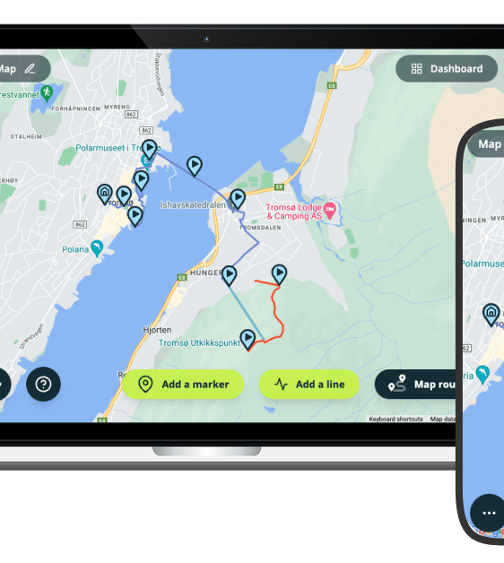
Visual Discovery
Interactive Map: Visual Discovery Experience
Core Map Features
Clickable Regions
Layered Data
All 24 governorates with hover states and click interactions
Toggle between states, hotels, attractions, zones
Zoom & Pan
Smart Filters
Smooth navigation with touch and mouse support
Filter by price, rating, amenities, hotel type
Availability Indicators
Route Planning
Real-time status with color-coded markers
Plan multi-destination itineraries
User Experience Benefits
40%
3x
25%
Faster discovery vs list-based
More engagement time
Higher conversion rate

Slide 7
AI Content Generation
AI-Powered State Descriptions
Automated Content Creation
Content Generation Stats
Our AI engine generates rich, contextual descriptions for all 24 Tunisian governorates by analyzing multiple data sources including historical records, cultural databases, tourism statistics, and local insights.
24
5
Governorates Covered
Languages Supported
Content Creation Time
-99%
Historical Facts
Cultural Highlights
Ancient civilizations, key events
Traditions, festivals, customs
SEO Optimization
100%
Update Frequency
Real-time
Climate & Seasons
Local Cuisine
Weather patterns, best times
Signature dishes, specialties
Multilingual Support
Dynamic Content Updates
Arabic
French
English
German
Italian
AI continuously updates descriptions based on seasonal trends, current events, and user feedback. Content remains fresh and relevant year-round, automatically adjusting for festivals, weather changes, and emerging attractions.

Slide 8
AI Content Generation
AI Hotel Description Engine
Intelligent Property Content
Efficiency Gains
Our AI analyzes hotel data from multiple sources—property details, amenities, guest reviews, location context, nearby attractions—to generate compelling, personalized descriptions that resonate with different traveler segments.
Traditional Method
2 days
AI-Powered
30 seconds
Data Sources
Segment Variants
Time Saved
99%
• Official hotel websites
• Business travelers
• Guest reviews & ratings
• Leisure & families
• Property amenities
• Couples & honeymooners
• Location coordinates
• Adventure seekers
SEO Benefits
• Nearby attractions
• Luxury preferences
Keyword-rich content
Structured data markup
Automatic Image Selection
Meta descriptions auto-gen
Image alt tags
AI suggests high-resolution images that match the generated description, ensuring visual consistency and appeal. Images are automatically tagged and optimized for SEO.

Slide 9
Intelligent Assistant
AI Travel Assistant: Conversational Intelligence
Natural Language Understanding
Assistant Performance
Our AI travel assistant understands complex traveler queries in natural language, providing personalized responses about Tunisia travel. From "What's the best time to visit the Sahara?" to "Recommend family-friendly hotels in Sousse with pools"—the assistant delivers contextual, helpful answers.
80%
90%
Inquiries Handled Automatically
Customer Satisfaction Rate
Response Time
< 2 sec
Availability
24/7
Personalized Recommendations
Languages
5+
Custom Itineraries
Travel Advice
AI-generated trip plans
Weather, customs, safety
Multilingual Conversations
Local Insights
Real-time Info
AR
FR
EN
DE
IT
Hidden gems, local tips
Events, conditions
العربية
Français
English
Deutsch
Italiano

Slide 10
Technical Architecture
Technology Stack & AI Integration
Frontend
Backend
AI Layer
HTML
Python Flask
Groq
CSS
Microservices
Fine-tuned Models
Javascript
GraphQL API
NLP Pipeline
WebSocket Support
Content Generation
Database & Storage
Cloud Infrastructure
PostgreSQL
PostGIS
AWS / Azure
Cloud hosting
Primary database
Geospatial data
Auto-scaling
Dynamic capacity
MongoDB
Redis
Security
SSL, encryption
Content storage
Caching layer

Slide 11
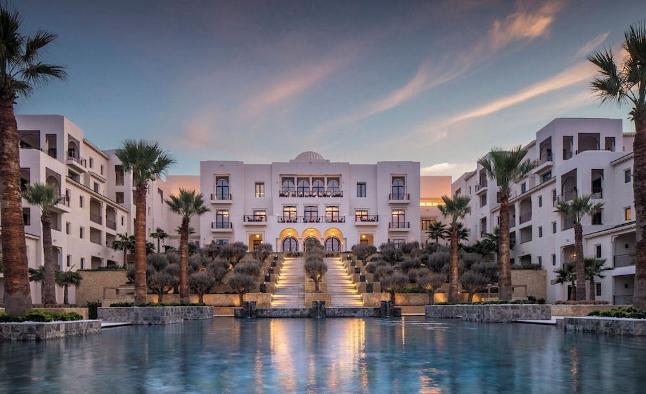
Conclusion
Leading Digital Transformation
in North African Tourism
Interactive Discovery
AI Content Engine
Travel Assistant
Visual map exploration of all 24 Tunisian governorates with layered information
Automated generation of state, hotel, and attraction descriptions in 5 languages
Conversational AI providing personalized travel advice and recommendations
Investment Opportunity
50K
Seeking $1M seed funding for platform development & market entry
Target Users Year 1

